Slide 1


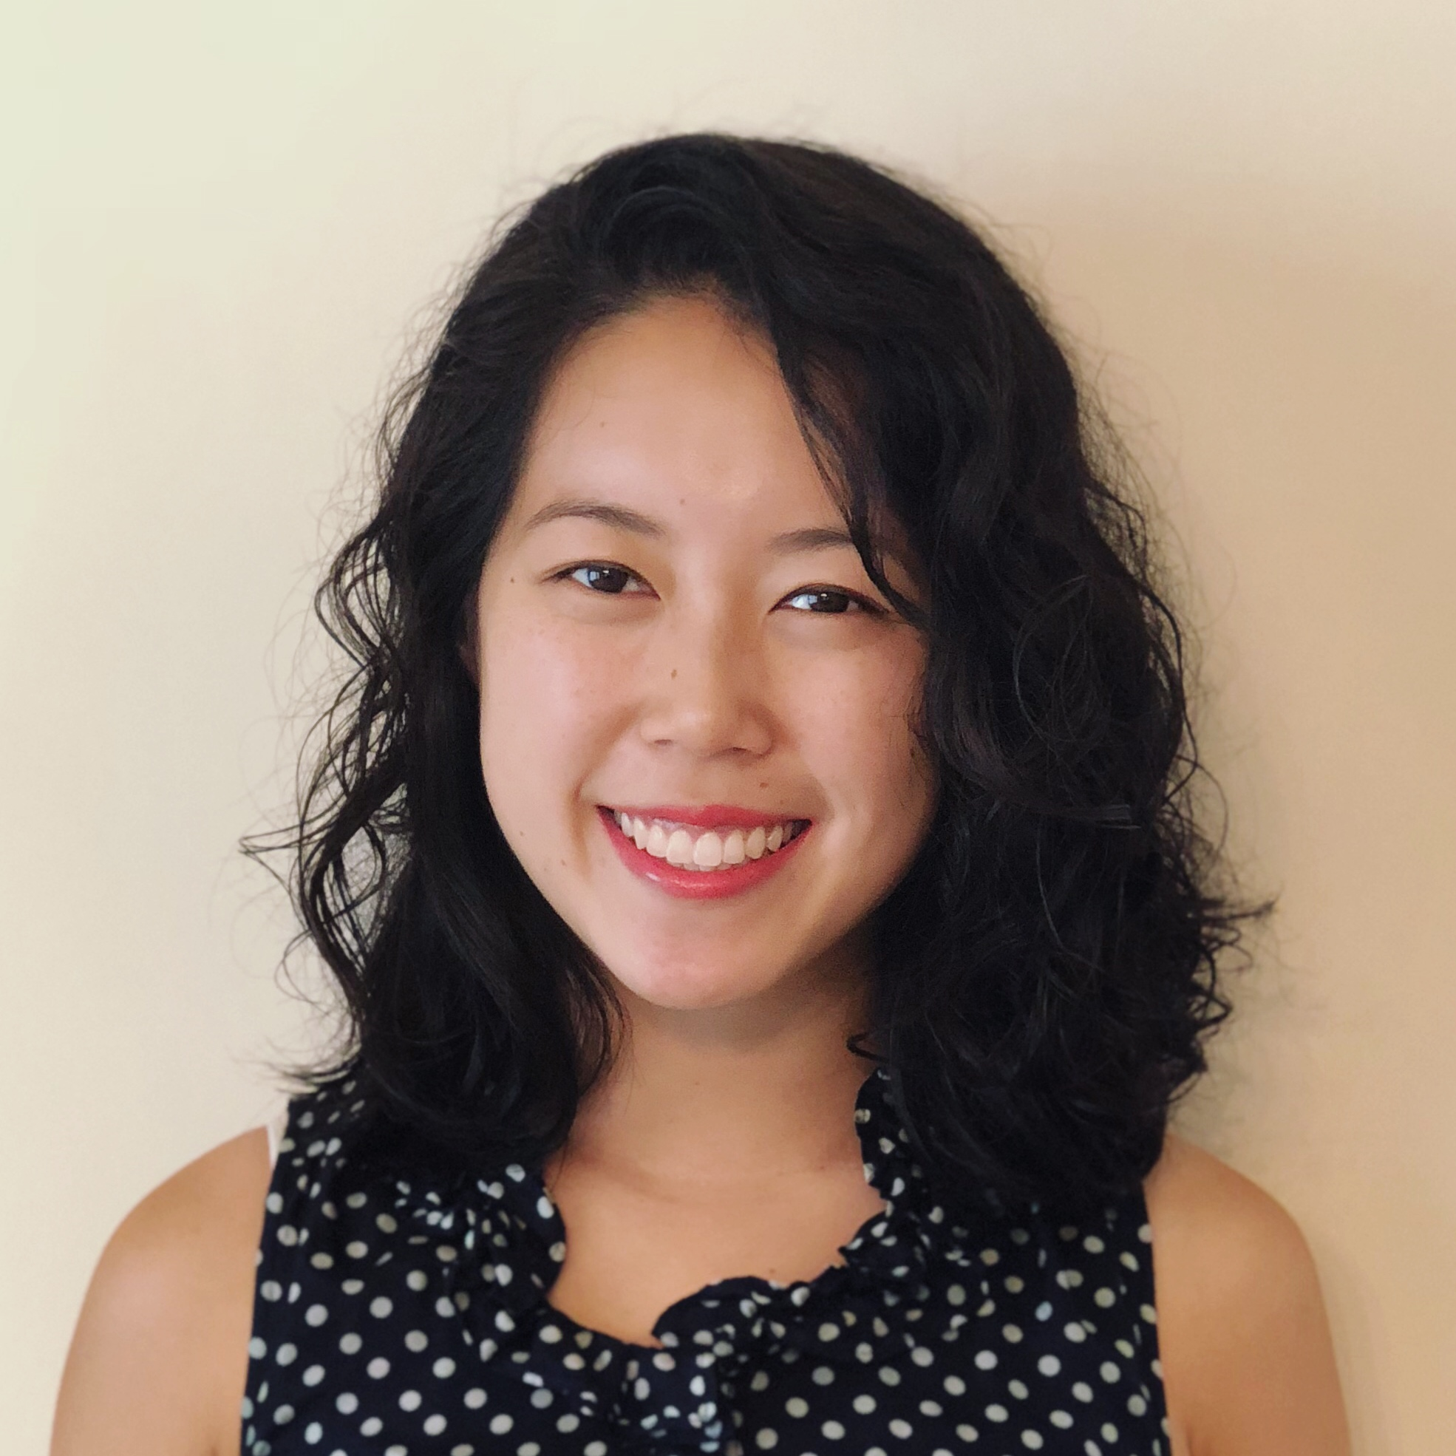
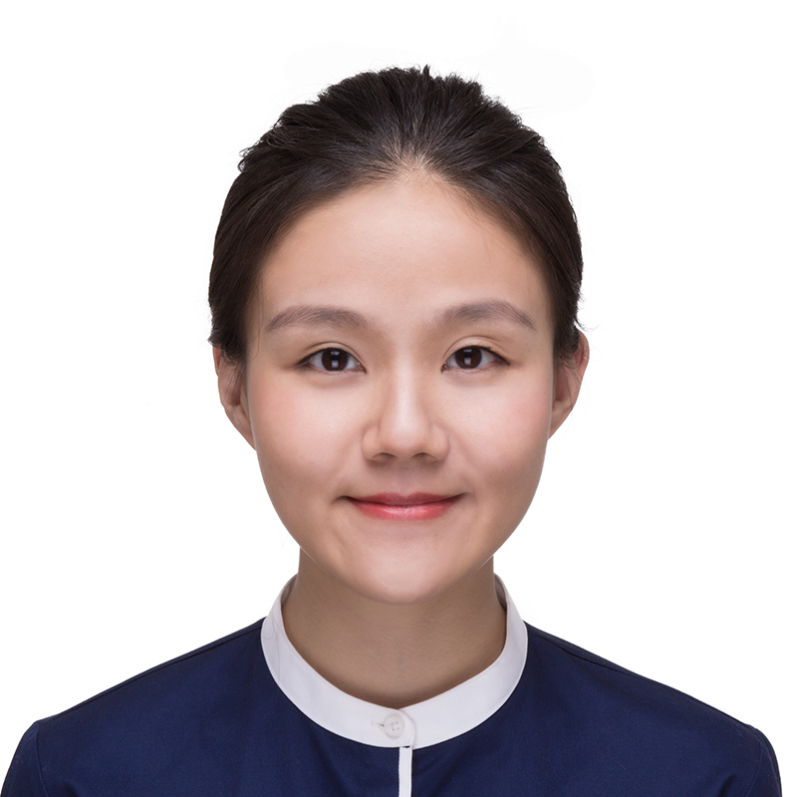
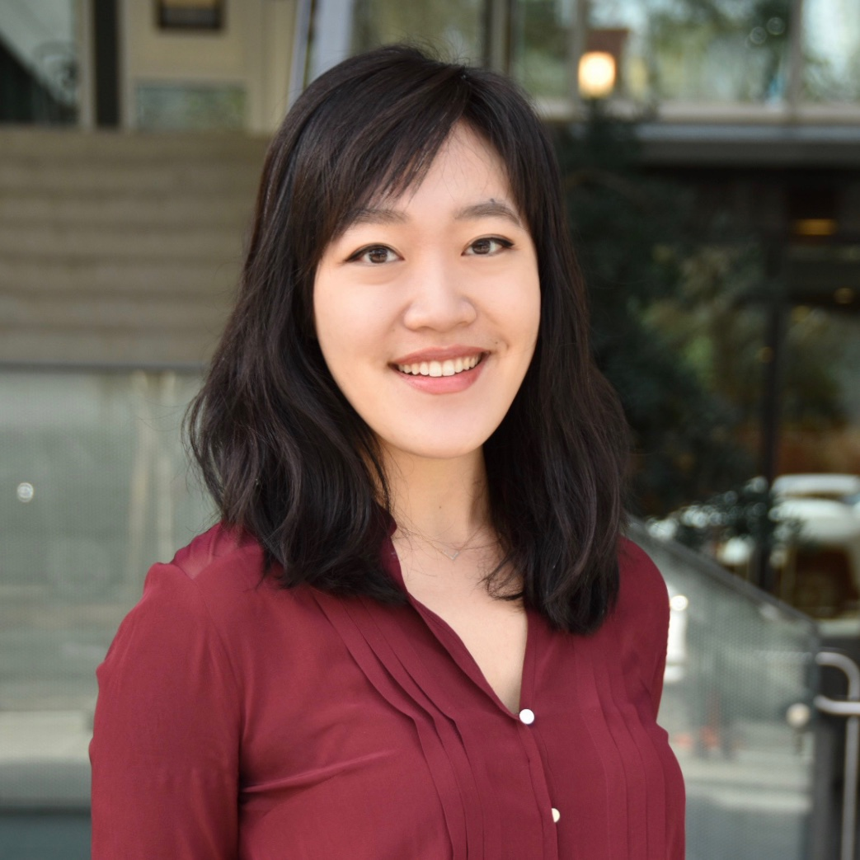
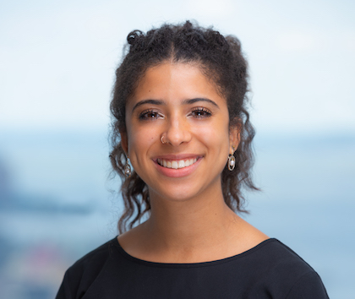
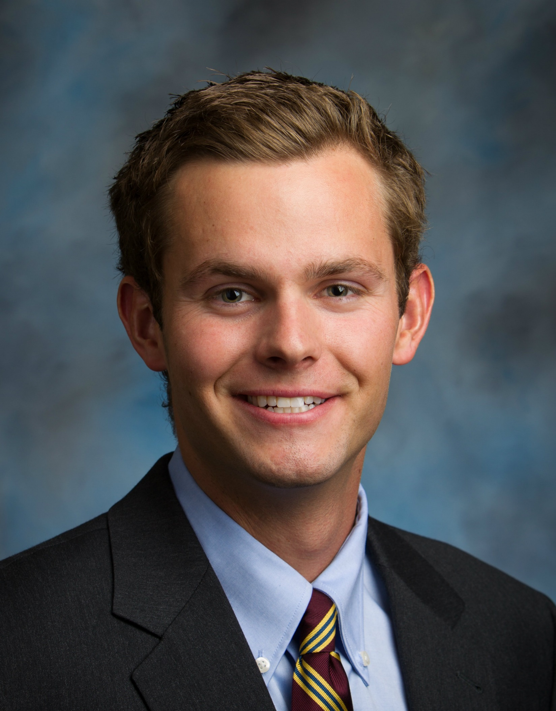

Your Harvard Team
Christina Wu
Mia Mayixuan Li
Gwendolyn Lee
Melia Henderson
Rob MacGregor
Christina is interested in applying design principles to improving the healthcare and social service systems for vulnerable populations, particularly aging individuals.
Christina previously worked in healthcare consulting, supporting clients including CMMI, HUD, and state Medicaid agencies. She is also experienced in digital health and managed care. She completed a Fulbright fellowship researching dementia care in China.
B.A. in Health & Societies, University of Pennsylvania; MPH in Health Policy, Harvard T.H. Chan School of Public Health (2020)
Mia is interested in introducing innovative technologies to strengthen good governance and improve the quality of service delivery in the developing world.
Mia previously worked for the United Nations Development Programme (UNDP) in China, where she developed communication strategies and managed projects in a broad range of development areas.
B.A. in economics and international development, Sarah Lawrence College; MPP, Harvard Kennedy School (2021)
Gwendolyn is interested in the intersection between health policy, population health, and digital health innovation.
Gwendolyn previously worked at the Massachusetts Health Policy Commission. She currently sources ventures using artificial intelligence and health tech for Innospark Ventures and Flare Capital Partners.
B.A. in the Woodrow Wilson School of Public & International Affairs, Princeton University; MPP, Harvard Kennedy School (2020); MD, UCLA (2022)
Melia is interested in building technology to help solve issues within government.
Melia previously worked as a software engineer as well as a consultant at Boston Consulting Group (BCG) and product manager at Digital Ventures, BCG’s technology incubator. Finally, she has done research in the security of government technology such as the 2020 US Census.
B.A. in computer science, Harvard University (2020)
Rob is interested in leveraging business and tech to mitigate public sector challenges.
Rob previously worked in investment banking, private equity, and venture capital. He also spent two years with the Clinton Health Access Initiative where he primarily advised the Government of Uganda on HIV funding and supply chain issues.
B.A. in economics and international relations, Claremont McKenna College; MPP, Harvard Kennedy School (2022); MBA, Wharton (2022)

Slide 2
Contact Information
Name | Mobile | Email
Gwendolyn Lee | 310-882-9681 | gwendolyn_lee@hks.harvard.edu
Mia Li | 617-852-1662 | miamayixuanli@hks.harvard.edu
Christina Wu | 443-745-8151 | christinawu@hsph.harvard.edu
Melia Henderson | 510-593-7359 | meliahenderson@college.harvard.edu
Rob MacGregor | 650-759-9452 | rmacgregor@hks.harvard.edu

